Slide 1




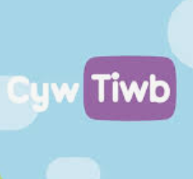





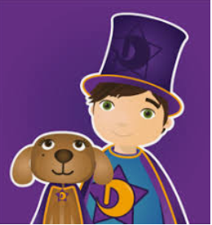



Apiau Cymraeg
Cyfnod Sylfaen / Foundation Phase
All available on Apple and on Android.
 | Cyfri gyda Cyw Learn numbers 1 – 10. Practise writing the numerals.
 | Cyw a’r Wyddor Learn the alphabet. Practise writing the letters.
 | Cyw Tiwb Allows you to watch the Welsh-medium children’s programmes that are shown on S4C. Watch live or click on a particular programme.
 | Alun yr Arth – Ar y Fferm Click on an area of the farmyard for activities such as dressing a bear, guessing the animal, paying for items in the farm shop, etc.
 | Tric a Chlic (Cam 1) Learn the letter sounds, how to write them and then play games to reinforce letter sounds and word recognition.
 | Tric a Chlic 2 (Cam 2 & 3) Play games to reinforce letter sounds and word recognition.
 | Llyfrau Bach Magi Ann; Llyfrau Hwyl Magi Ann 1 – 5 Simple stories with sound and English translations. Six apps each containing several stories.
 | Symud Selog Learn the names of words connected with the garden, the woods and the beach. Learn the words to Welsh yard games.
 | Dewin a Doti Set of 4 stories about Dewin and Doti. Click on the speech bubble to hear the pages being read.
 | Bys a Bawd Recordings of Welsh nursery rhymes being sung simply with the words on the screen. It shows English translations too.
 | Hoff Ganeuon Selog Recordings of Welsh nursery rhymes being sung simply with the words on the screen. It shows English translations too
 | Canu Selog 2 Traditional songs, including one with the Welsh alphabet, days of the week and months of the year.

